Slide 1
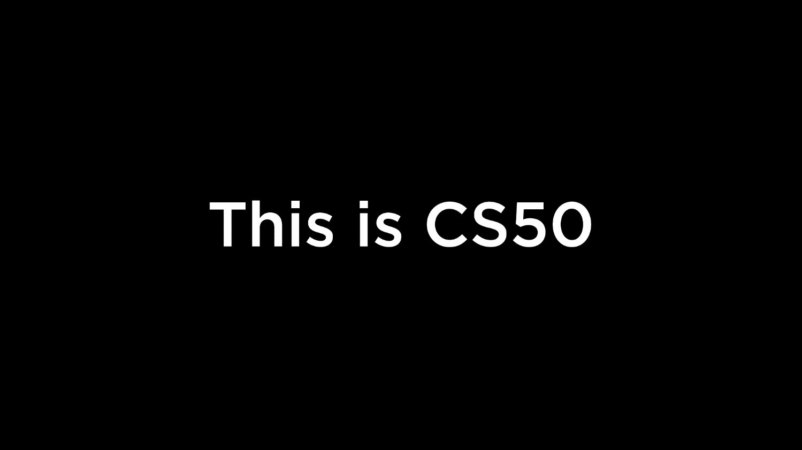
Notes:
Reload codespace
Uncheck VS Code tabs

Slide 2
This is CS50
Visit cs50.ly/screen to view projector on your laptop and ask questions via chat.
Today's snacks will be whoopie pies! 🟤
If you didn't get a rubber duck 🦆 yet, ask Carter during break or after class!
If you'd like to attend CS50 Lunch this Fri 10/6 at 1:15pm, RSVP at cs50.ly/lunch!
Do say hi or ask questions during break or after class!

Slide 4
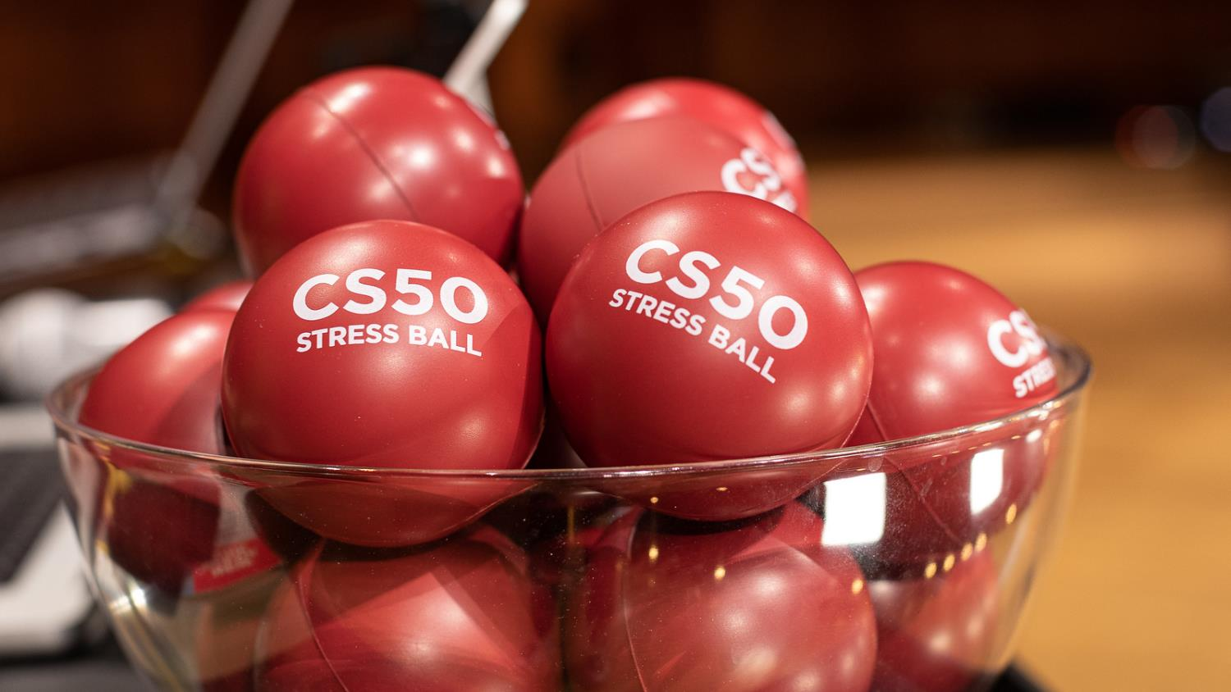

Slide 5
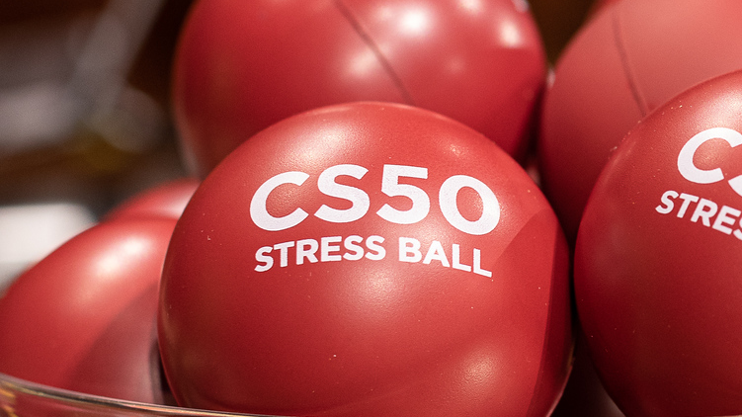

Slide 6
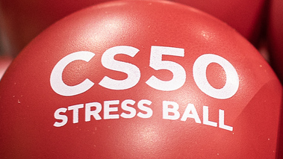

Slide 7


Slide 8


Slide 9


Slide 10
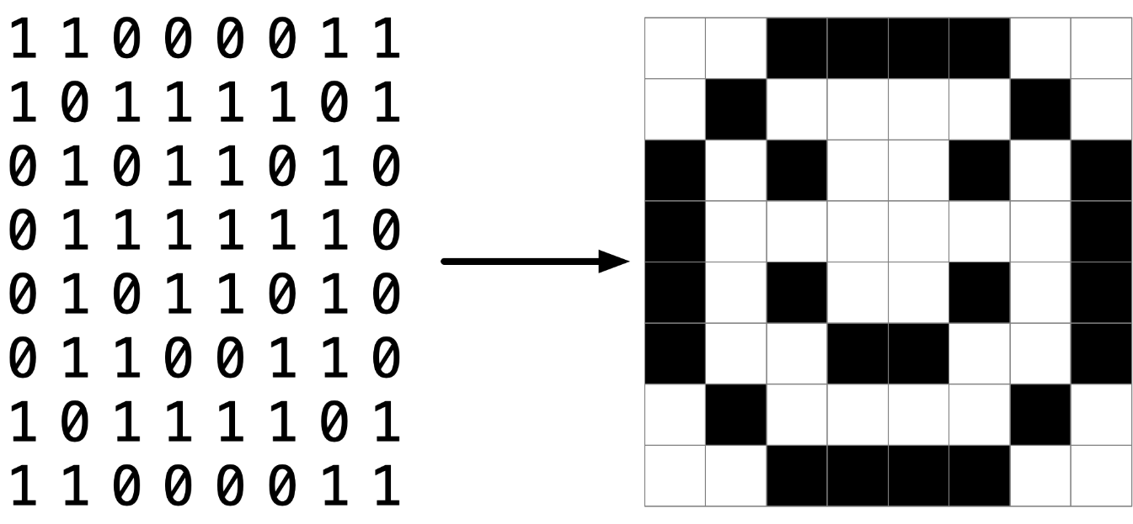

Slide 13
pixel art
Notes:
Reveal volunteer's artwork on stage, if any; invite others to make their own and send it to us

Slide 14
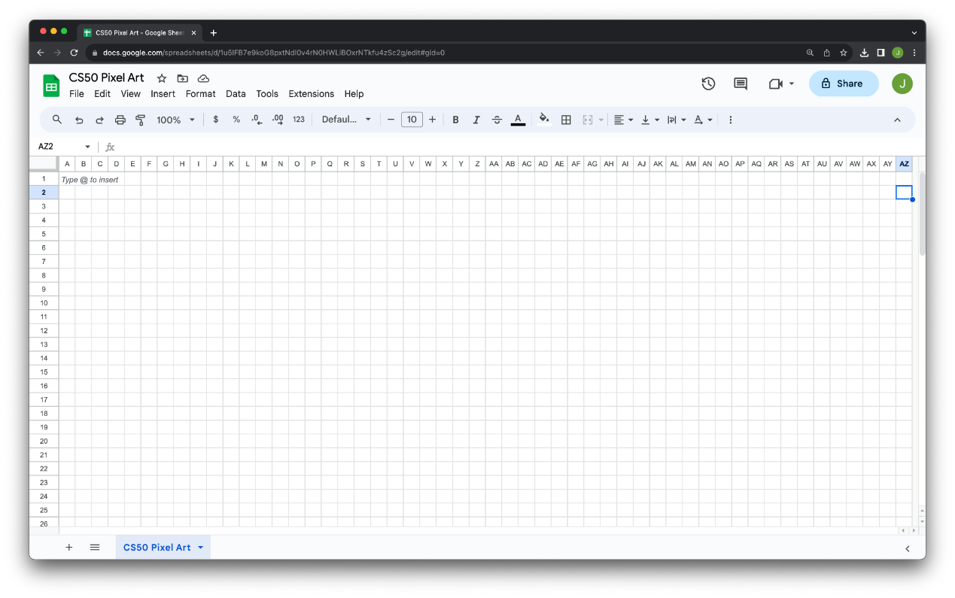

Slide 15
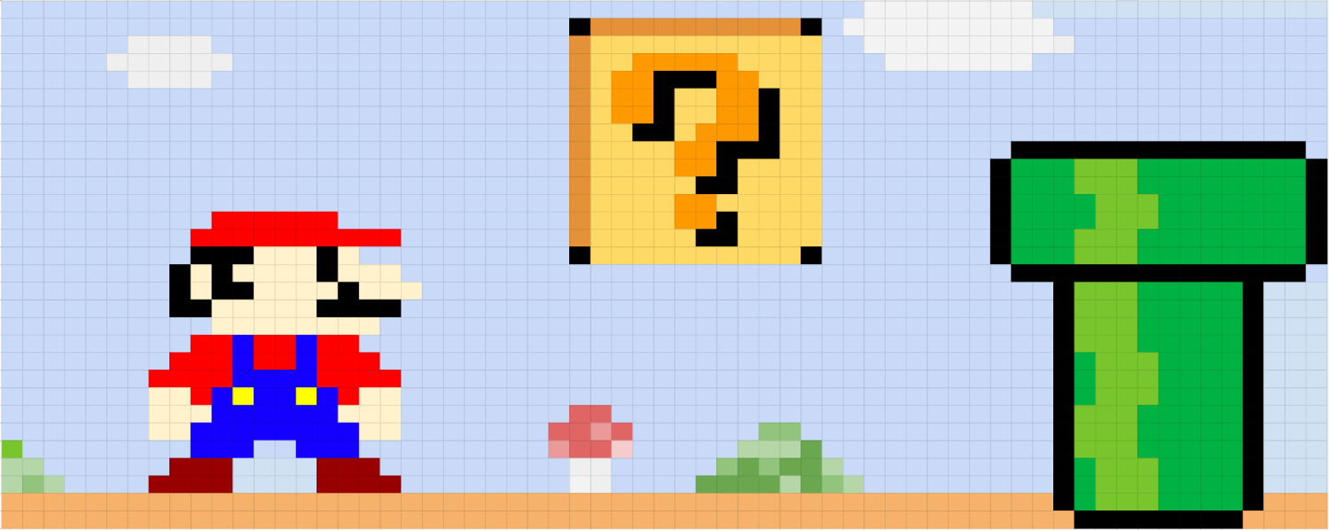

Slide 16
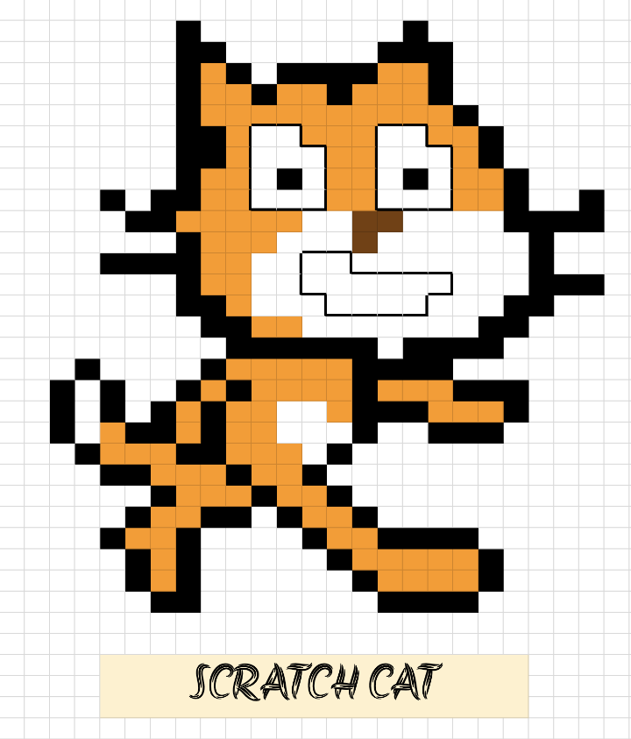

Slide 17
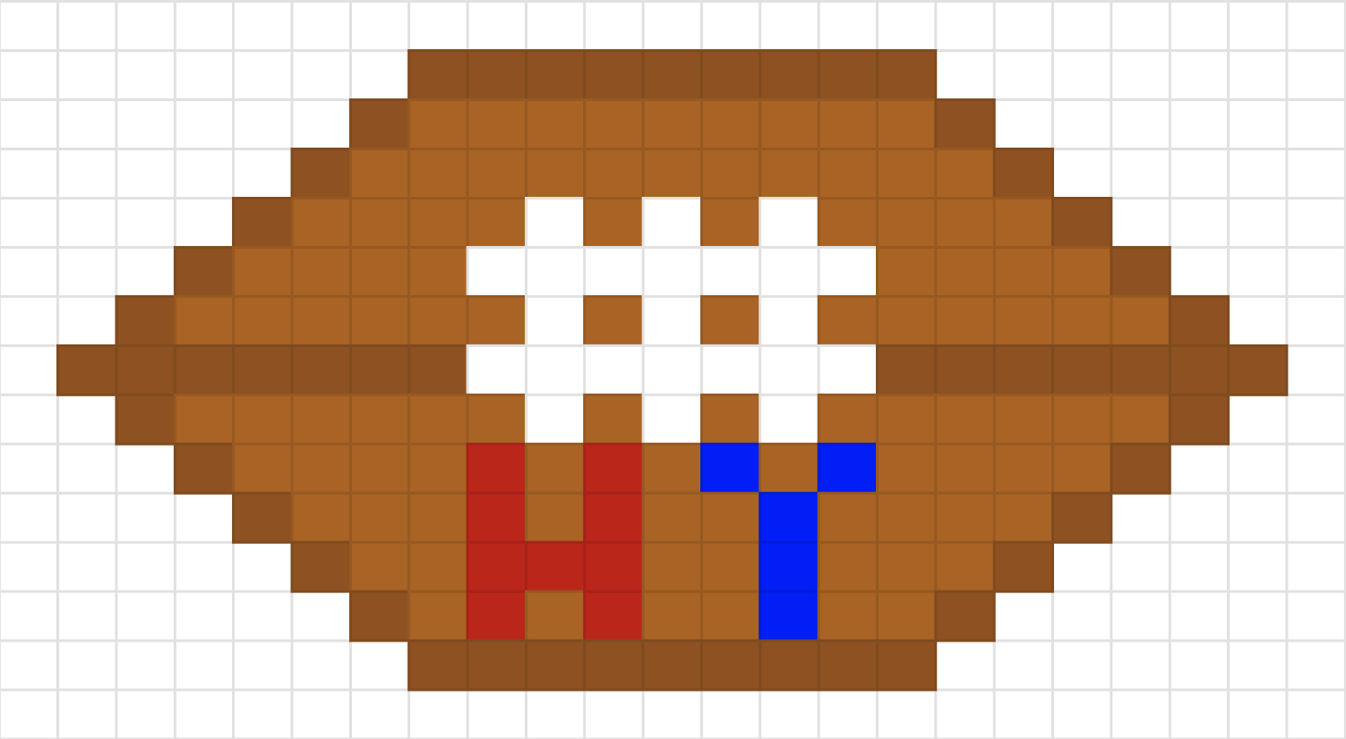

Slide 18


Slide 19
cs50.ly/art
Notes:
Reveal volunteer's artwork on stage, if any; invite others to make their own and send it to us

Slide 20
RGB

Slide 21
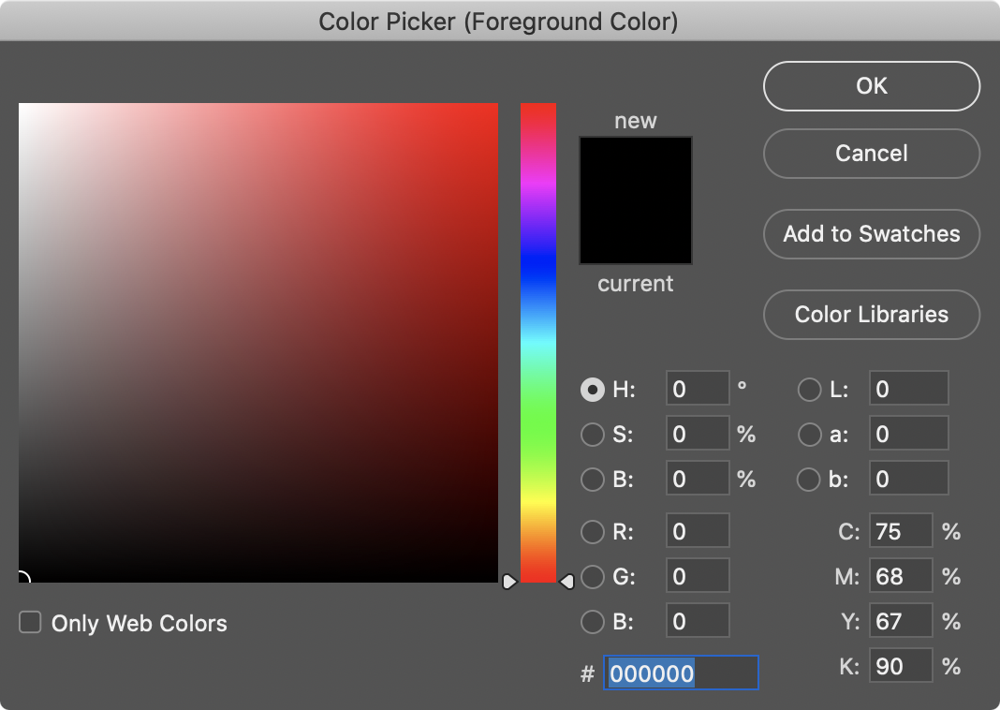

Slide 22
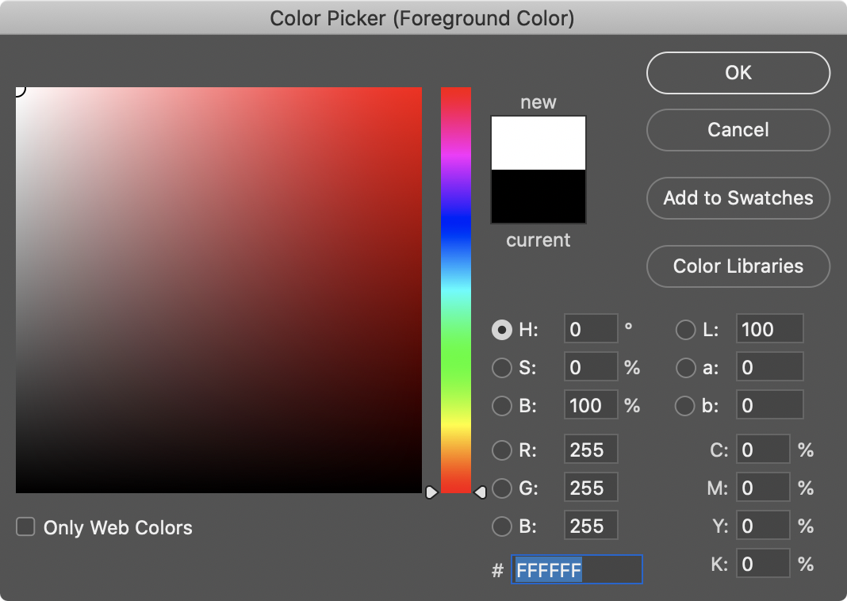
Notes:
White is 255 255 255. But what are these F's? hmmm

Slide 23
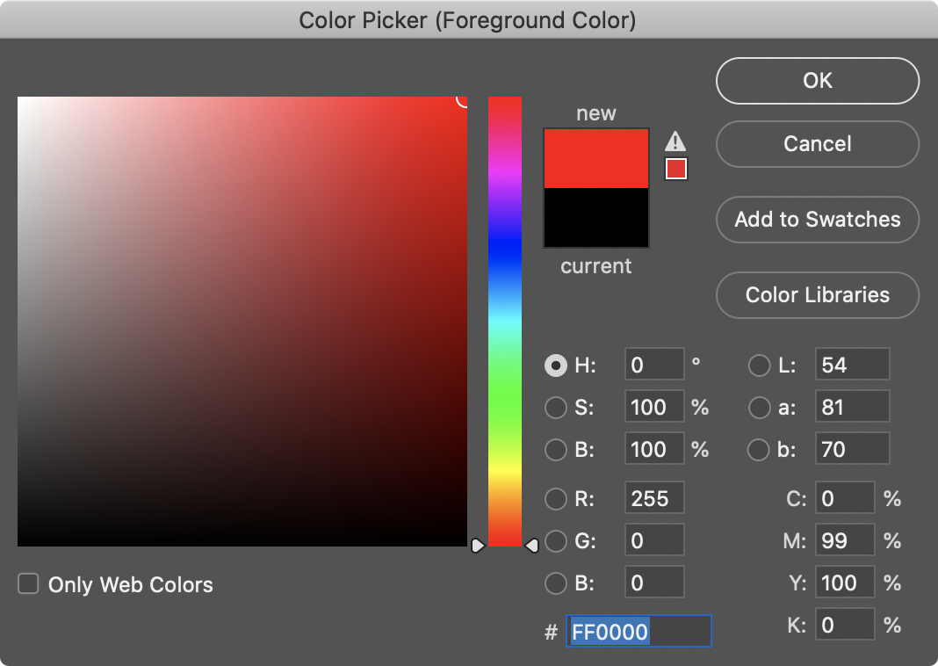

Slide 24
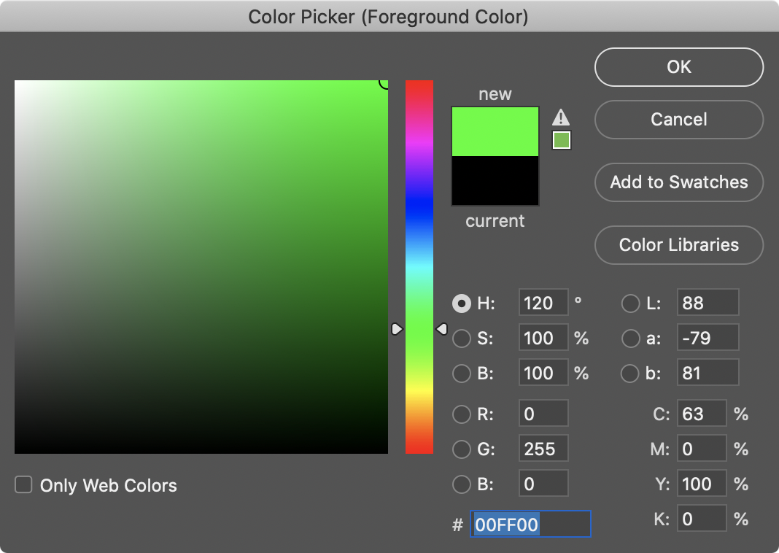

Slide 25
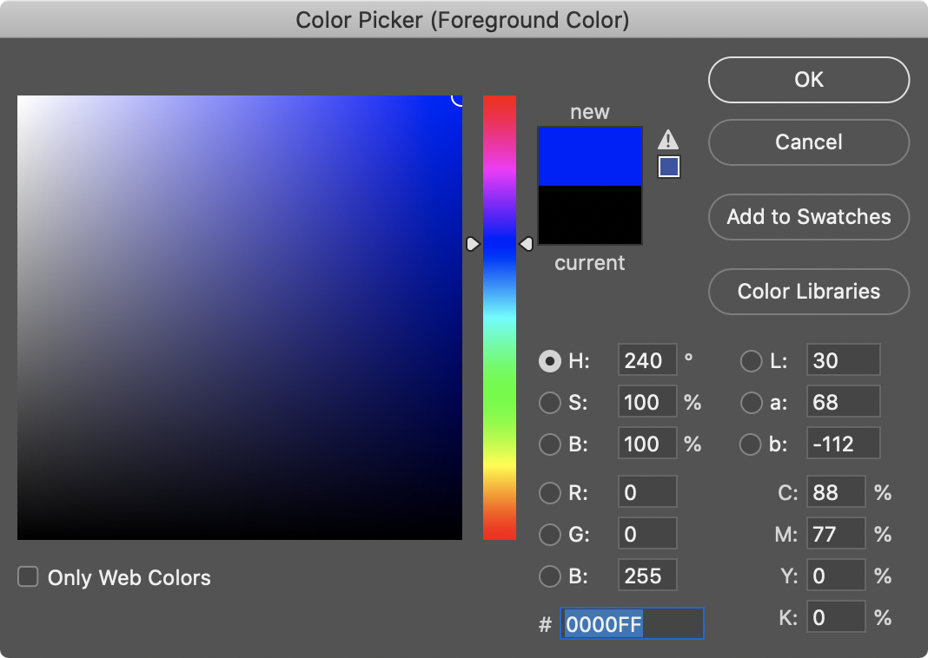

Slide 26
0 1 2 3 4 5 6 7 8 9 A B C D E F

Slide 27
0 1 2 3 4 5 6 7 8 9 A B C D E F

Slide 28
0 1 2 3 4 5 6 7 8 9 A B C D E F

Slide 29
0 1 2 3 4 5 6 7 8 9 a b c d e f

Slide 30
hexadecimal

Slide 31
base-16

Slide 32
16¹
16⁰
# #

Slide 33
16
1
# #

Slide 34
16
1
00

Slide 35
16
1
01

Slide 36
16
1
02

Slide 37
16
1
03

Slide 38
16
1
04

Slide 39
16
1
05

Slide 40
16
1
06

Slide 41
16
1
07

Slide 42
16
1
08

Slide 43
16
1
09

Slide 44
16
1
0A
Notes:
"ten"

Slide 45
16
1
0B
Notes:
"eleven"

Slide 46
16
1
0C

Slide 47
16
1
0D

Slide 48
16
1
0E

Slide 49
16
1
0F

Slide 50
16
1
10
Notes:
"one zero" not "ten"

Slide 51
16
1
11
Notes:
"one one", not "eleven"

Slide 52
16
1
12

Slide 53
16
1
13

Slide 54
16
1
14

Slide 55
16
1
…

Slide 56
16
1
FF

Slide 57
16
1
FF
16 × F
+
1 × F

Slide 58
16
1
FF
16 × 15
+
1 × 15

Slide 59
16
1
FF
240
+
15

Slide 60
16
1
FF
255
Notes:
So why is hex popular?

Slide 61
F

Slide 62
1111

Slide 63
11111111

Slide 64
FF

Slide 66
0 | 1 | 2 | 3 | 4 | 5 | 6 | 7
8 | 9 | 10 | 11 | 12 | 13 | 14 | 15
16 | 17 | 18 | 19 | 20 | 21 | 22 | 23
24 | 25 | 26 | 27 | 28 | 29 | 30 | 31

Slide 67
0 | 1 | 2 | 3 | 4 | 5 | 6 | 7
8 | 9 | A | B | C | D | E | F
10 | 11 | 12 | 13 | 14 | 15 | 16 | 17
18 | 19 | 1A | 1B | 1C | 1D | 1E | 1F

Slide 68
0 | 1 | 2 | 3 | 4 | 5 | 6 | 7
8 | 9 | A | B | C | D | E | F
10 | 11 | 12 | 13 | 14 | 15 | 16 | 17
18 | 19 | 1A | 1B | 1C | 1D | 1E | 1F

Slide 69
0x0 | 0x1 | 0x2 | 0x3 | 0x4 | 0x5 | 0x6 | 0x7
0x8 | 0x9 | 0xA | 0xB | 0xC | 0xD | 0xE | 0xF
0x10 | 0x11 | 0x12 | 0x13 | 0x14 | 0x15 | 0x16 | 0x17
0x18 | 0x19 | 0x1A | 0x1B | 0x1C | 0x1D | 0x1E | 0x1F

Slide 70
int n = 50;
Notes:
addresses0.c
Consider this code, how's it stored in memory?

Slide 72
 |  |  |  | 50 n

Slide 73
 |  |  |  | 50 0x123

Slide 74
&
*
address of
Notes:
addresses1.c
It turns out C has two operators that let us see and access addresses like that

Slide 75
pointers
Notes:
A pointer is essentially an address, or more precisely a variable that can store an address.

Slide 76
int n = 50;
int *p = &n;
Notes:
addresses{2,3}.c

Slide 77
int n = 50;
int *p = &n;

Slide 78
int n = 50;
int* p = &n;
notation used to imply type declared is integer pointer

Slide 79
int n = 50;
int * p = &n;
whitespace does not matter

Slide 80
int n = 50;
int *p = &n;

Slide 82
 |  |  |  | 50 n

Slide 83
 |  |  |  | 50 0x123

Slide 84
0x123 p
 |  |  |  | 50 0x123

Slide 85
0x123 p
 |  |  |  | 50 0x123

Slide 86
p
 |  |  |  | 50 0x123
Notes:
MAILBOX DEMO

Slide 87
string

Slide 88
string s = "HI!";

Slide 89
 |  |  | H | I | ! | \0

Slide 90
 |  |  | H s[0] | I s[1] | ! s[2] | \0 s[3]

Slide 91
 |  |  | H 0x123 | I 0x124 | ! 0x125 | \0 0x126

Slide 92
s
 |  |  | H 0x123 | I 0x124 | ! 0x125 | \0 0x126
Notes:
addresses{4,5}.c

Slide 93
0x123 s
 |  |  | H 0x123 | I 0x124 | ! 0x125 | \0 0x126
Notes:
addresses{4,5}.c
TODO: add addresses4.5 and just print address of s

Slide 94
s
 |  |  | H 0x123 | I 0x124 | ! 0x125 | \0 0x126 | 0x127
Notes:
But who cares about the specific addresses, think of this just as a pointer literally, an arrow.

Slide 95
string s = "HI!";
Notes:
addresses6.c

Slide 96
string s = "HI!";

Slide 97
char *s = "HI!";
string is actually a char* having NUL \0 to indicate end of sequence
whereas char is a single 1byte character without a NUL \0 ending
Notes:
addresses7.c
DROP TRAINING WHEELS.
It's just an address.

Slide 98
typedef struct
{
string name;
string number;
} person;
Notes:
So what is "string"? It's a type we defined for you. In fact, recall how we made our own type last week for a person.

Slide 99
give me a data type called person…
typedef struct
{
string name;
string number;
} person;

Slide 100
… that is this whole structure
typedef struct
{
string name;
string number;
} person;

Slide 101
typedef struct
{
string name;
string number;
} person;

Slide 102
typedef int integer;
Notes:
For instance, you could alias "integer" to be the same as "int". But no need to do that.

Slide 103
typedef int integer;
give me a data type called integer…

Slide 104
typedef int integer;
… that is actually an int

Slide 105
typedef uint8_t BYTE;
a user friendly typedef

Slide 106
typedef uint8_t BYTE;
give me a data type called BYTE…

Slide 107
typedef uint8_t BYTE;
… that is actually an unsigned integer with 8 bits
which is a data type declared in some other C header file

Slide 108
typedef char *string;
typedef used in #cs50.h

Slide 109
typedef char *string;

Slide 110
typedef char *string;

Slide 111
cs50.h

Slide 112
pointer arithmetic
Notes:
addresses{8,9}.c
Were these ints instead of chars, you would still do +1, and the compiler would know that it's really +4.

Slide 113
Notes:
https://www.youtube.com/watch?v=I_8ZH1Ggjk0
https://www.youtube.com/watch?v=WwnI0RS6J5A

Slide 114
Notes:
compare0.c

Slide 115
50 i |  |  |  | 50 j

Slide 116
Notes:
Now recall last week that we had to use strcmp to compare strings. Why was that?
compare{1,2}.c
Have to type "HI!"

Slide 117
s

Slide 118
s
 |  | H | I | ! | \0

Slide 119
s
 |  | H 0x123 | I 0x124 | ! 0x125 | \0 0x126

Slide 120
0x123 s
 |  | H 0x123 | I 0x124 | ! 0x125 | \0 0x126

Slide 121
0x123 s |  |  |  |  |  |  |  | t
 |  | H 0x123 | I 0x124 | ! 0x125 | \0 0x126

Slide 122
0x123 s |  |  |  |  |  |  |  | t
 |  | H 0x123 | I 0x124 | ! 0x125 | \0 0x126 |  |  |  |  | H | I | ! | \0

Slide 123
0x123 s |  |  |  |  |  |  |  | t
 |  | H 0x123 | I 0x124 | ! 0x125 | \0 0x126 |  |  |  |  | H 0x456 | I 0x457 | ! 0x458 | \0 0x459

Slide 124
0x123 s |  |  |  |  |  |  |  | 0x456 t
 |  | H 0x123 | I 0x124 | ! 0x125 | \0 0x126 |  |  |  |  | H 0x456 | I 0x457 | ! 0x458 | \0 0x459

Slide 125
s |  |  |  |  |  |  |  | t
 |  | H 0x123 | I 0x124 | ! 0x125 | \0 0x126 |  |  |  |  | H 0x456 | I 0x457 | ! 0x458 | \0 0x459
Notes:
compare{3,4}.c

Slide 126
Notes:
copy{0,1}.c
Have to use "hi!" in lowercase

Slide 127
s

Slide 128
s
 |  | h | i | ! | \0

Slide 129
s
 |  | h 0x123 | i 0x124 | ! 0x125 | \0 0x126

Slide 130
0x123 s
 |  | h 0x123 | i 0x124 | ! 0x125 | \0 0x126

Slide 131
0x123 s |  |  |  |  |  |  |  | t
 |  | h 0x123 | i 0x124 | ! 0x125 | \0 0x126

Slide 132
0x123 s |  |  |  |  |  |  |  | 0x123 t
 |  | h 0x123 | i 0x124 | ! 0x125 | \0 0x126

Slide 133
s |  |  |  |  |  |  |  | t
 |  | h 0x123 | i 0x124 | ! 0x125 | \0 0x126

Slide 134
s |  |  |  |  |  |  |  | t
 |  | H 0x123 | i 0x124 | ! 0x125 | \0 0x126

Slide 135
malloc
free
…
Notes:
copy{2,3,4}.c

Slide 136
s
 |  | h 0x123 | i 0x124 | ! 0x125 | \0 0x126

Slide 137
s |  |  |  |  |  |  |  | t
 |  | h 0x123 | i 0x124 | ! 0x125 | \0 0x126

Slide 138
s |  |  |  |  |  |  |  | t
 |  | h 0x123 | i 0x124 | ! 0x125 | \0 0x126 |  |  |  |  | 0x456 | 0x457 | 0x458 | 0x459

Slide 139
s |  |  |  |  |  |  |  | t
 |  | h 0x123 | i 0x124 | ! 0x125 | \0 0x126 |  |  |  |  | 0x456 | 0x457 | 0x458 | 0x459

Slide 140
s |  |  |  |  |  |  |  | t
 |  | h 0x123 | i 0x124 | ! 0x125 | \0 0x126 |  |  |  |  | h 0x456 | 0x457 | 0x458 | 0x459

Slide 141
s |  |  |  |  |  |  |  | t
 |  | h 0x123 | i 0x124 | ! 0x125 | \0 0x126 |  |  |  |  | h 0x456 | i 0x457 | 0x458 | 0x459

Slide 142
s |  |  |  |  |  |  |  | t
 |  | h 0x123 | i 0x124 | ! 0x125 | \0 0x126 |  |  |  |  | h 0x456 | i 0x457 | ! 0x458 | 0x459

Slide 143
s |  |  |  |  |  |  |  | t
 |  | h 0x123 | i 0x124 | ! 0x125 | \0 0x126 |  |  |  |  | h 0x456 | i 0x457 | ! 0x458 | \0 0x459

Slide 144
s |  |  |  |  |  |  |  | t
 |  | h 0x123 | i 0x124 | ! 0x125 | \0 0x126 |  |  |  |  | H 0x456 | i 0x457 | ! 0x458 | \0 0x459

Slide 145
NULL
Notes:
copy5.c

Slide 146
valgrind
Notes:
memory.c, create in advance
[Note: not necessary to free strings returned by get_string, CS50's library does for you.]

Slide 147
garbage values
Notes:
garbage.c

Slide 148
int main(void)
{
int *x;
int *y;
x = malloc(sizeof(int));
*x = 42;
*y = 13;
y = x;
*y = 13;
}

Slide 149
int main(void)
{
int *x;
int *y;
x = malloc(sizeof(int));
*x = 42;
*y = 13;
y = x;
*y = 13;
}

Slide 150
int main(void)
{
int *x;
int *y;
x = malloc(sizeof(int));
*x = 42;
*y = 13;
y = x;
*y = 13;
}

Slide 151
int main(void)
{
int *x;
int *y;
x = malloc(sizeof(int));
*x = 42;
*y = 13;
y = x;
*y = 13;
}

Slide 152
int main(void)
{
int *x;
int *y;
x = malloc(sizeof(int));
*x = 42;
*y = 13;
y = x;
*y = 13;
}

Slide 153
int main(void)
{
int *x;
int *y;
x = malloc(sizeof(int));
*x = 42;
*y = 13;
y = x;
*y = 13;
}
Notes:
So maybe we shouldn't do that

Slide 154
int main(void)
{
int *x;
int *y;
x = malloc(sizeof(int));
*x = 42;
*y = 13;
y = x;
*y = 13;
}
Notes:
But what if we instead…

Slide 155
int main(void)
{
int *x;
int *y;
x = malloc(sizeof(int));
*x = 42;
*y = 13;
y = x;
*y = 13;
}

Slide 156
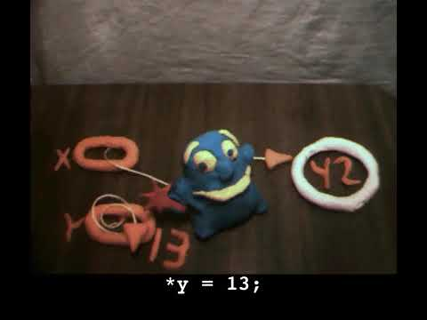
Notes:
https://www.youtube.com/watch?v=3uLKjb973HU

Slide 157
void swap(int a, int b)
{
}
Notes:
DRINKING GLASS DEMO

Slide 158
void swap(int a, int b)
{
int tmp = a;
a = b;
b = tmp;
}
Notes:
swap0.c
Have this one ready to go in a swap.c file

Slide 159
void swap(int a, int b)
{
int tmp = a;
a = b;
b = tmp;
}

Slide 160
scope

Slide 161
passing by value

Slide 162
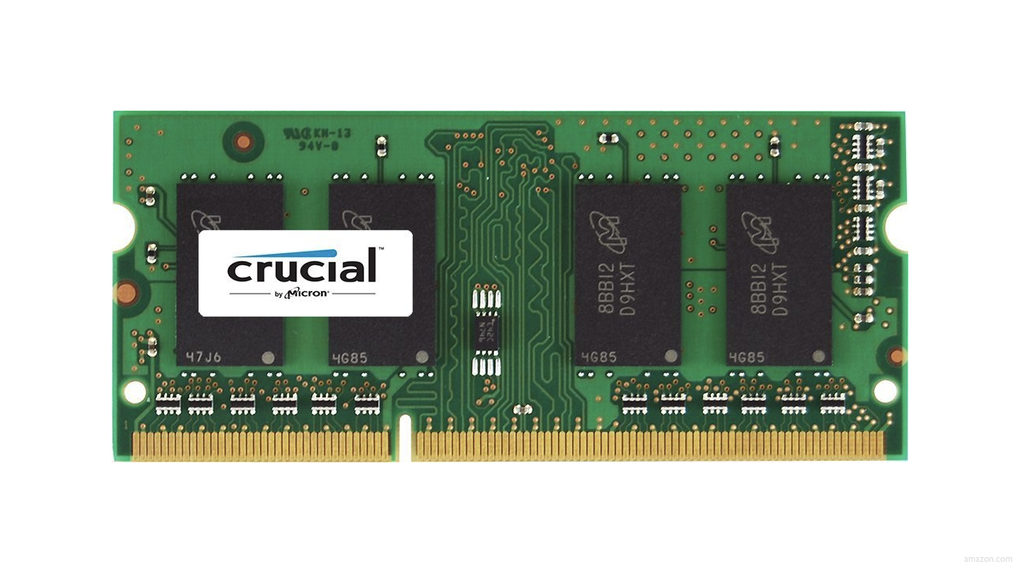

Slide 166
↑
stack

Slide 167
machine code
↑
stack

Slide 168
machine code
globals
heap
↓
↑
stack

Slide 169
machine code
globals
heap
↓
↑
stack

Slide 170
machine code
globals
heap
↓
↑
stack

Slide 171
machine code
globals
heap
↓
↑
stack

Slide 172
machine code
globals
heap
↓
↑
stack

Slide 173
↑
stack
Notes:
show swap0.c again

Slide 174
void swap(int a, int b)
{
int tmp = a;
a = b;
b = tmp;
}

Slide 175
main

Slide 176
swap
main

Slide 177
main

Slide 178
x
y

Slide 179
1
x
2
y

Slide 180
swap
1
x
2
y

Slide 181
a
b
tmp
1
x
2
y

Slide 182
1
a
2
b
tmp
1
x
2
y

Slide 183
int tmp = a;
a = b;
b = tmp;
1
a
2
b
tmp
1
x
2
y

Slide 184
int tmp = a;
a = b;
b = tmp;
1
a
2
b
1
tmp
1
x
2
y

Slide 185
int tmp = a;
a = b;
b = tmp;
2
a
2
b
1
tmp
1
x
2
y

Slide 186
int tmp = a;
a = b;
b = tmp;
2
a
1
b
1
tmp
1
x
2
y

Slide 187
2
a
1
b
1
tmp
1
x
2
y

Slide 188
1
x
2
y

Slide 189
passing by reference
Notes:
so how fix?

Slide 190
void swap(int a, int b)
{
int tmp = a;
a = b;
b = tmp;
}

Slide 191
void swap(int *a, int *b)
{
int tmp = *a;
*a = *b;
*b = tmp;
}
Notes:
swap1.c

Slide 192
1
x
2
y

Slide 193
a
b
tmp
1
x
2
y

Slide 194
int tmp = *a;
*a = *b;
*b = tmp;
a
b
tmp
1
x
2
y

Slide 195
int tmp = *a;
*a = *b;
*b = tmp;
a
b
1
tmp
1
x
2
y

Slide 196
int tmp = *a;
*a = *b;
*b = tmp;
a
b
1
tmp
2
x
2
y

Slide 197
int tmp = *a;
*a = *b;
*b = tmp;
a
b
1
tmp
2
x
1
y

Slide 198
a
b
1
tmp
2
x
1
y

Slide 199
2
x
1
y

Slide 200
void swap(int a, int b)
{
int tmp = a;
a = b;
b = tmp;
}

Slide 201
void swap(int *a, int *b)
{
int tmp = *a;
*a = *b;
*b = tmp;
}

Slide 202
machine code
globals
heap
↓
↑
stack

Slide 203
heap
↓
↑
stack
Notes:
What's bad about this picture?

Slide 204
heap overflow
stack overflow

Slide 205
buffer overflow

Slide 206
get_char
get_double
get_float
get_int
get_long
get_string
...
Notes:
So how about these other training wheels?

Slide 207
scanf
...
Notes:
get0.c

Slide 209


Slide 210
 | 50 n
Notes:
get1.c

Slide 212
s
Notes:
get2.c

Slide 214
s

Slide 215
file I/O

Slide 216
fopen
fclose
fprintf
fscanf
fread
fwrite
fseek
…
Notes:
phonebook{0,1}.c
cp.c

Slide 217
BMP

Slide 218
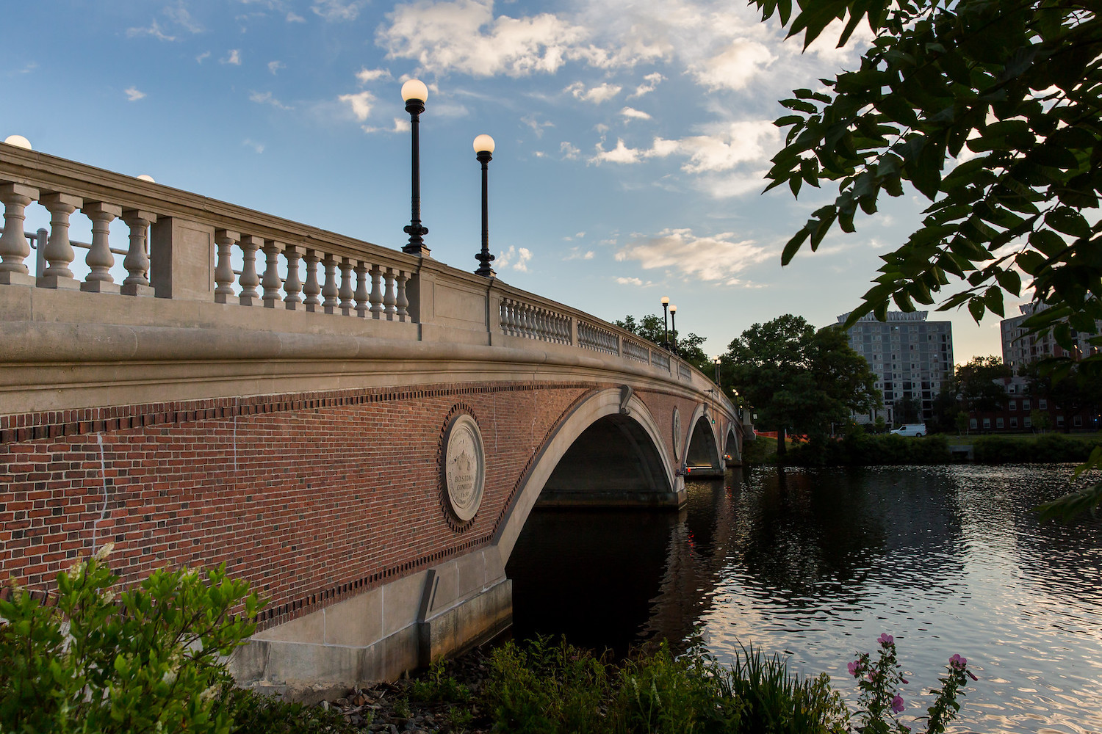

Slide 219
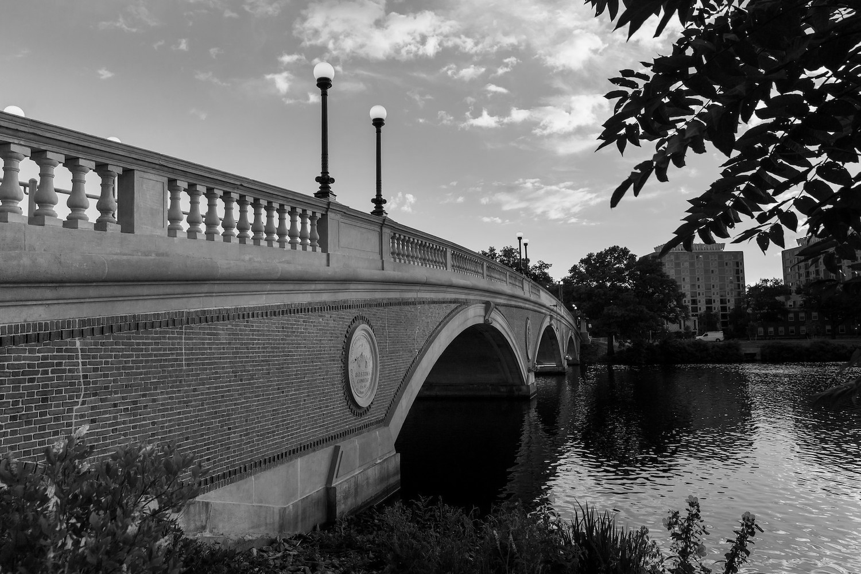
Notes:
grayscale

Slide 220
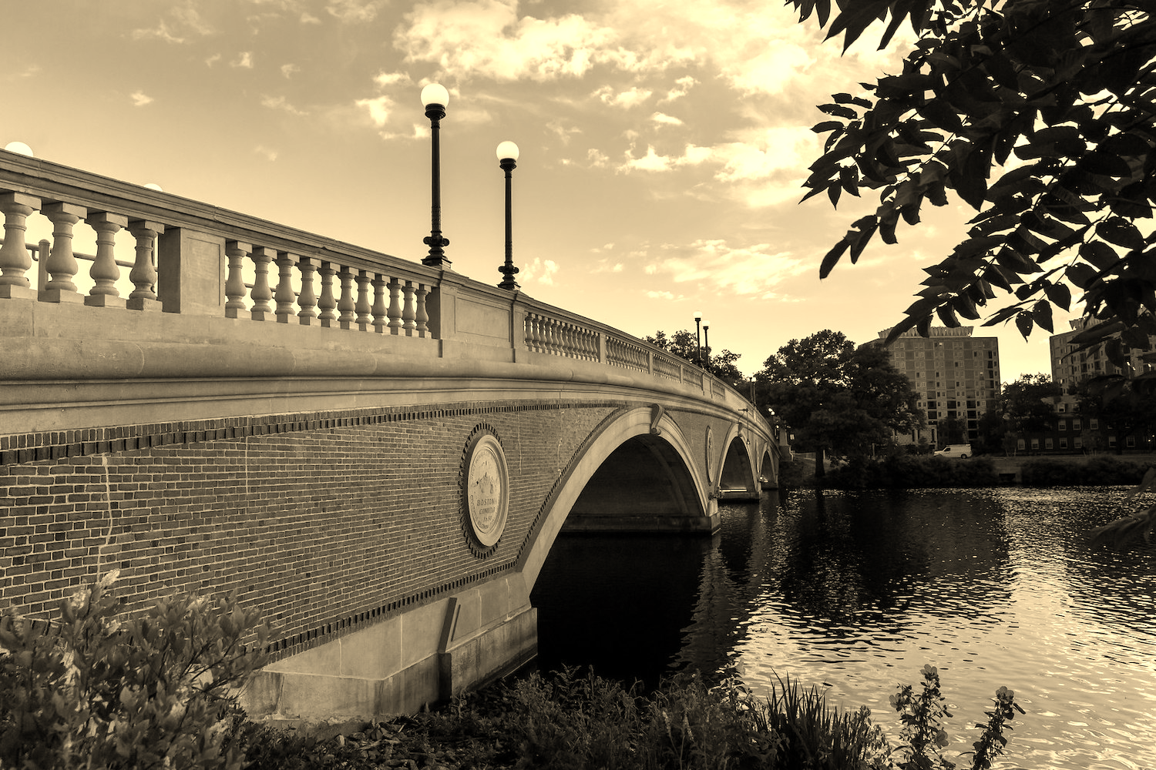
Notes:
sepia

Slide 221
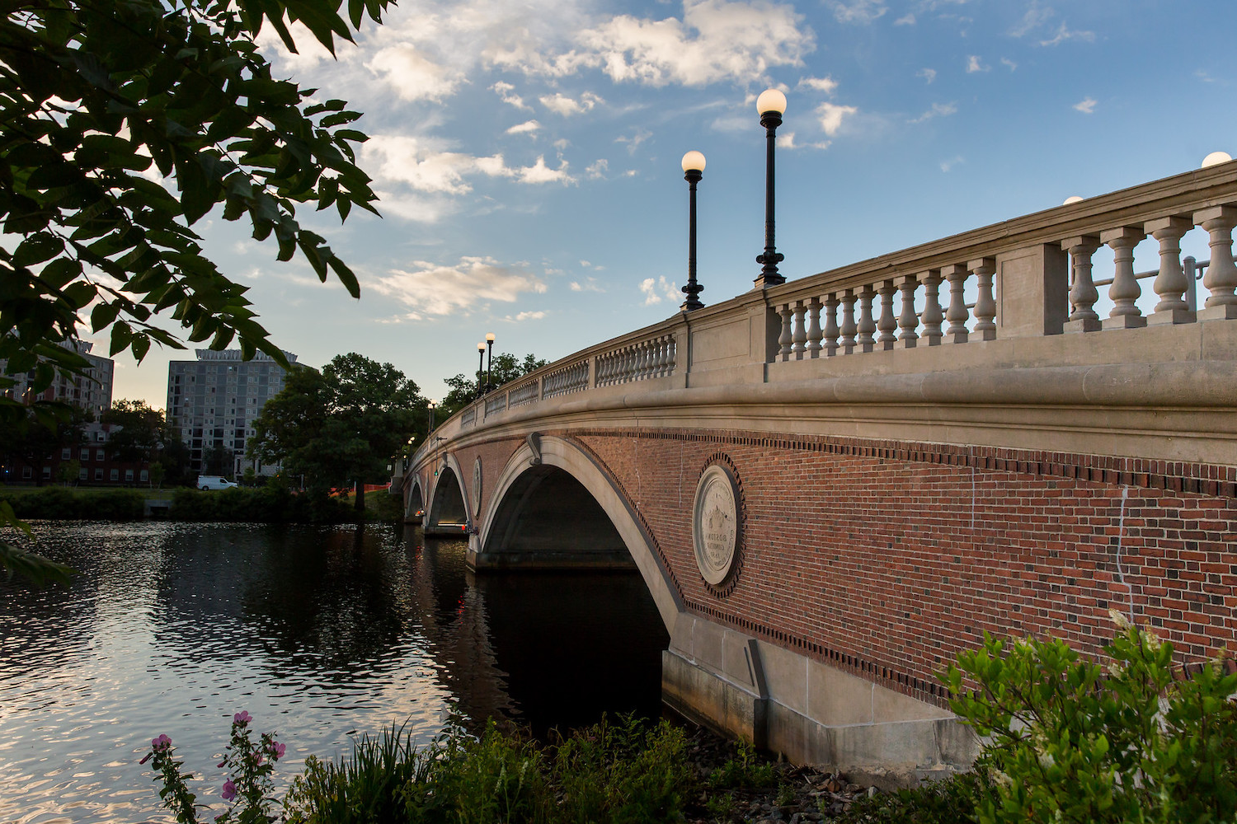
Notes:
reflect

Slide 222

Notes:
blur

Slide 223
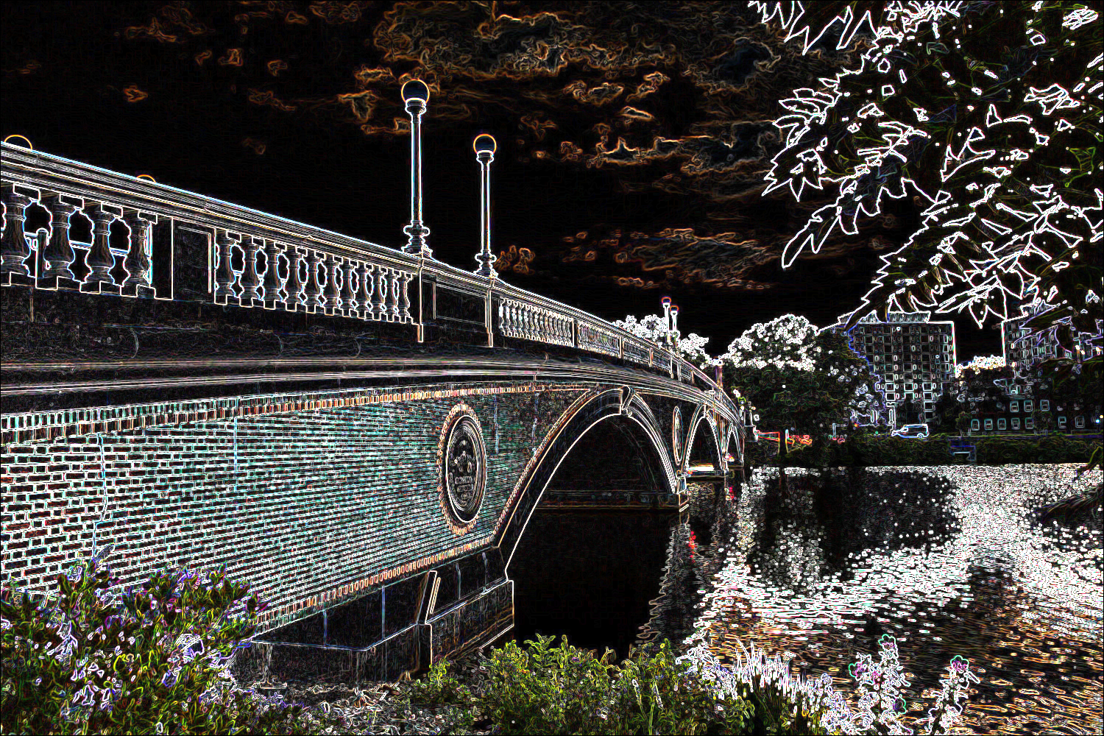
Notes:
edge detection

Slide 224
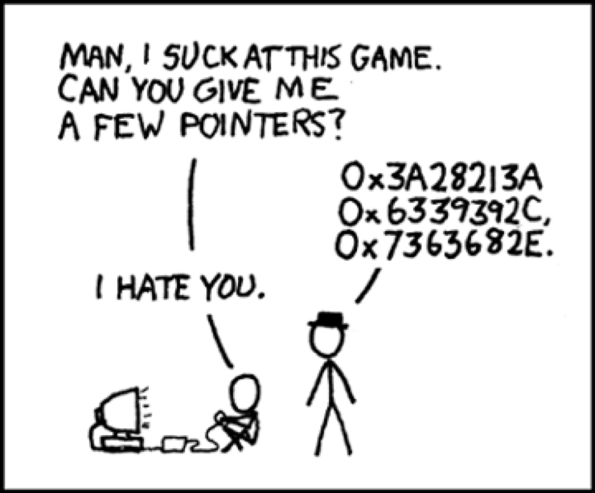
Notes:
https://xkcd.com/138/

